Slide 1


PREDICTING YOUTUBE VIDEO VIRALITY USING CONTENT, CREATOR, AND ENGAGEMENT ATTRIBUTES
An end-to-end ML pipeline for actionable virality prediction
COURSE & TERM
TEAM 3
MSDS_420 & Team 3
Max Chalekson | Selin Altiparmak | Yedong Deng

Slide 2



PROBLEM STATEMENT & RESEARCH QUESTIONS
BUSINESS CONTEXT
RESEARCH QUESTIONS
Problem: Identifying viral potential early enough to optimize promotion and content strategy.
Which features (creator vs. content) best predict video views?
Unit of Analysis: Individual YouTube videos (one video per row).
Are creator-level features more influential than content-level features?
Target Variable: log1p(view_count) to stabilize extreme variance.
Which model class performs best on this tabular dataset?
Leakage Policy: No post-upload engagement (likes/comments) used for prediction.

Slide 3

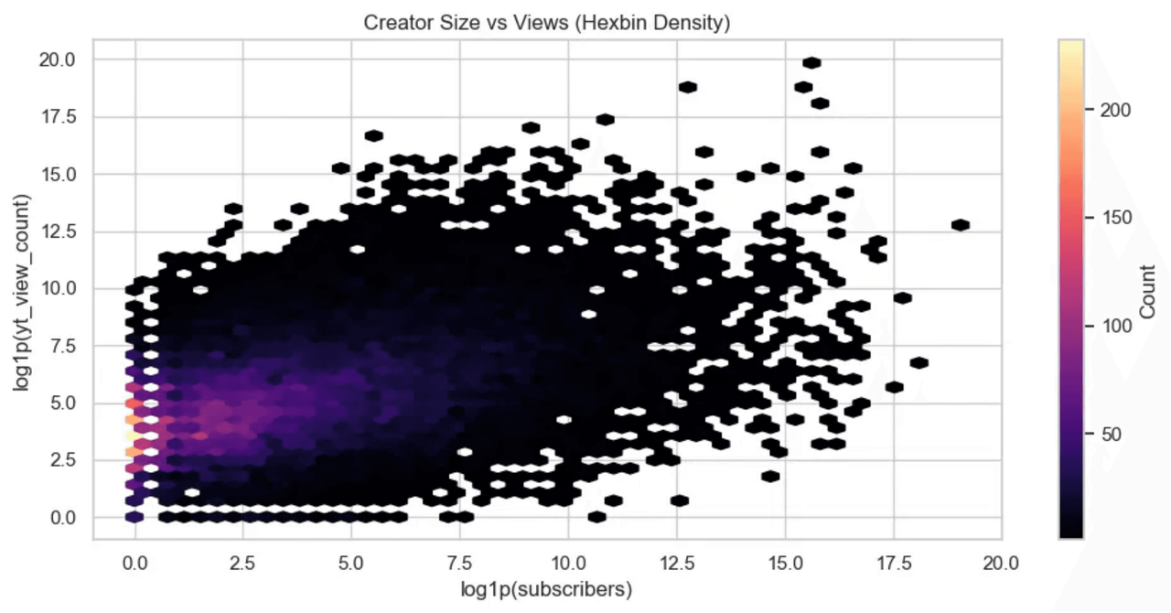
LITERATURE REVIEW: STRUCTURAL DRIVERS OF VIRALITY
CREATOR SOCIAL CAPITAL
Subscriber Base: Strongly predicts views, likes, and comments (Hussain et al. 2024).
Exposure Networks: Larger channels benefit from accumulated audience reach, amplifying initial visibility.
Platform Inequality: YouTube follows a "winner-take-most" distribution where top creators capture disproportionate attention.
Figure 1: Hexbin density plot showing the strong positive correlation between creator size (subscribers) and video views.

Slide 4


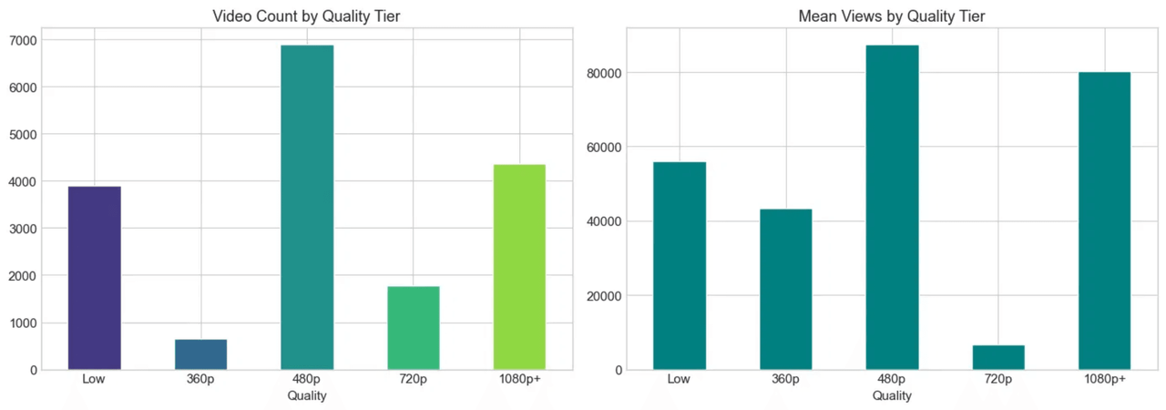
LITERATURE REVIEW: VISUAL ATTENTION & PLATFORM DYNAMICS
VISUAL & NONLINEAR DRIVERS
Thumbnail Salience: Brightness and colorfulness act as heuristics for content quality, influencing click-through (Koh & Cui 2022).
Nonlinear Dynamics: Virality emerges from complex interactions, not linear additive effects (Peng & Bainbridge 2026).
Duration Myth: No consistent linear relationship between video length and engagement (Konukoğlu & Özman 2025).
Figure 2: Higher quality tiers (1080p+) correlate with significantly higher mean views, supporting the visual quality hypothesis.

Slide 5
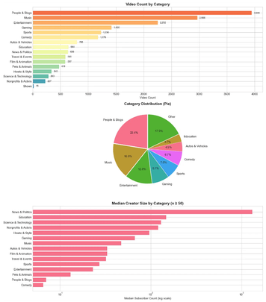


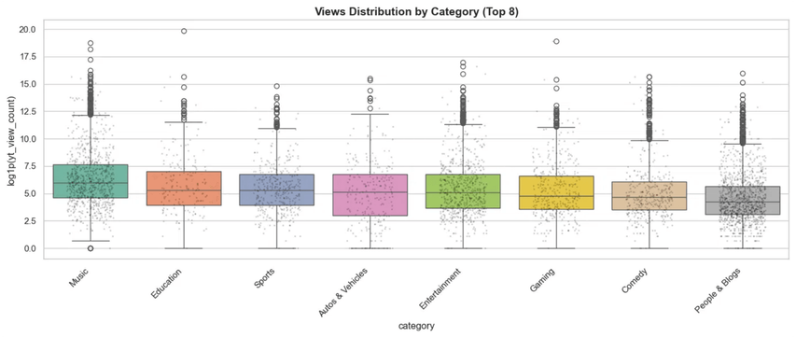
EXPLORATORY DATA ANALYSIS: CATEGORY & DISTRIBUTION
CATEGORY DISTRIBUTION
Dominant Categories:
People & Blogs, Music, and Entertainment account for >50% of the dataset.
Creator Size:
News & Politics channels have the highest median subscriber count.
VIEWS DISTRIBUTION BY CATEGORY (LOG-SCALE)

Slide 6

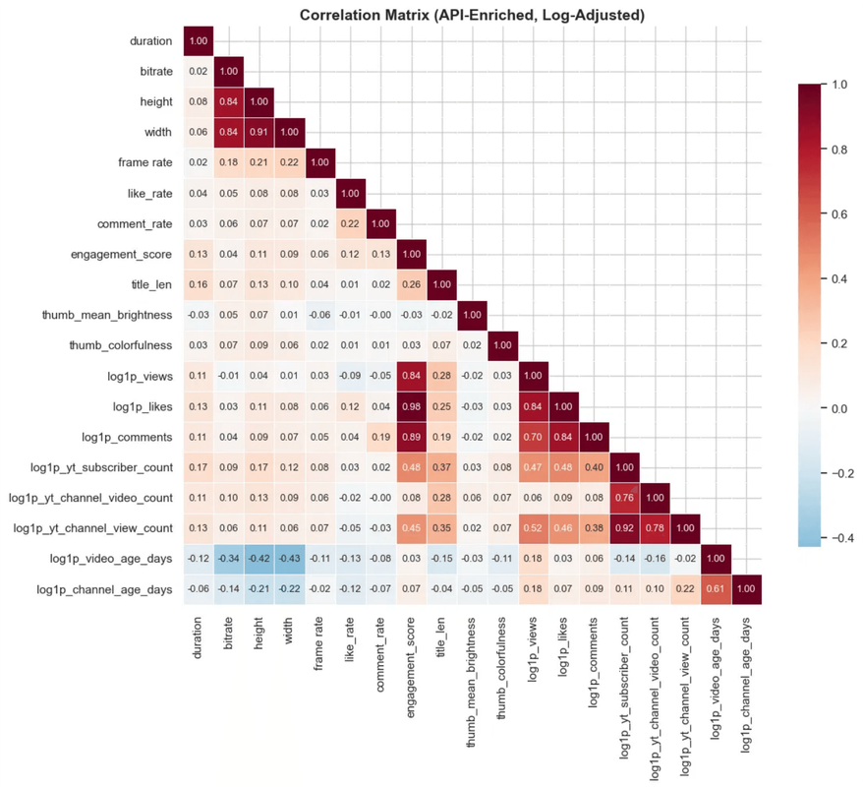
EXPLORATORY DATA ANALYSIS: CORRELATION & FEATURES
STRUCTURAL HIERARCHY
Channel Dominance: Subscriber count and historical views show stronger correlation with video views than content features.
Engagement Clustering: Views, likes, and comments are highly collinear, validating the use of views as the primary target.
Weak Content Signal: Duration and frame rate show negligible linear correlation with performance.
Figure 3: Correlation matrix highlighting the strong relationship between channel-level variables and engagement metrics.

Slide 7

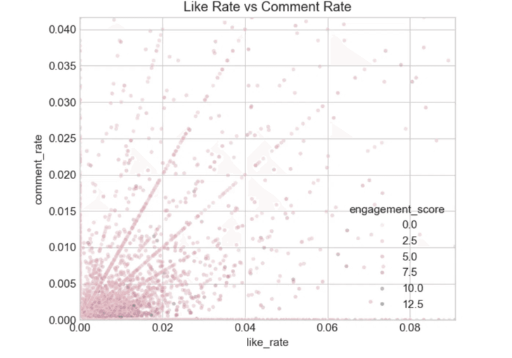
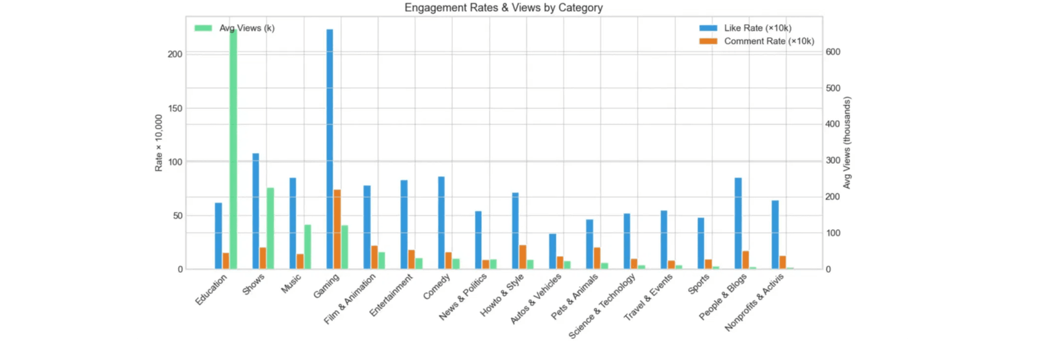
EDA: ENGAGEMENT PATTERNS & DISTRIBUTION
LOG-TRANSFORMED ENGAGEMENT DISTRIBUTIONS
RIGHT-SKEWED DISTRIBUTIONS
After log1p transformation, views approximate a
normal distribution (peak ~5.0), while likes and
comments remain right-skewed with zero-inflation.
IMPLICATION
The skewness justifies using log-transformed views
as the regression target, reducing the influence of
viral outliers on model training.
LIKE RATE VS COMMENT RATE
ENGAGEMENT RATES & VIEWS BY CATEGORY

Slide 8



FEATURE ENGINEERING & PREPROCESSING
CREATOR FEATURES
TEMPORAL FEATURES
CONTENT PROXIES
Subscriber count
Video age (days since upload)
Title & description length
Total channel views
Channel age (account maturity)
Thumbnail brightness
Historical avg views/video
Upload frequency metrics
Thumbnail colorfulness
PREPROCESSING PIPELINE
Imputation
Encoding
Scaling
Leakage Check
Median (Numeric) / Mode (Cat)
One-Hot for Categories
StandardScaler for NN/KNN
Strict Feature Isolation

Slide 9


METHODOLOGY & EXPERIMENTAL SETUP
EXPERIMENTAL DESIGN
MODEL EVALUATION
Data Split: 80% Training / 20% Testing with a fixed random seed for reproducibility.
Models Evaluated:
• Elastic Net
BASELINE
Hyperparameter Tuning: 5-fold GridSearchCV applied to the Random Forest model.
• KNN Regressor
• Random Forest Regressor
Selection Criterion: Best generalization on test RMSE + model interpretability.
• MLP Regressor
NEURAL NET
Performance Metrics: RMSE, MAE, and R² (calculated on log-transformed views).

Slide 10
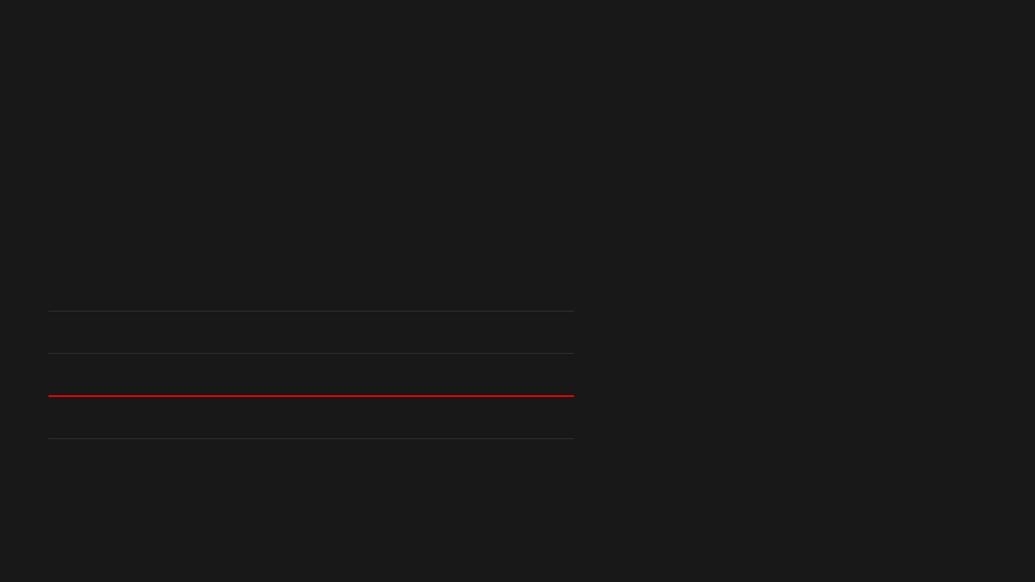

FINDINGS & MODEL COMPARISON
PERFORMANCE METRICS
KEY INTERPRETATIONS
MODEL
RMSE
MAE
R²
Social Capital Dominance: Creator-level features (subscribers/history) are the strongest predictors.
Elastic Net
1.852
1.420
0.451
KNN Regressor
1.710
1.305
0.512
Visual Signal: Thumbnail variables add secondary but statistically meaningful signal.
Random Forest (Tuned)
1.507
1.120
0.621
Nonlinear Advantage: Tree-based models outperform linear ones due to complex feature interactions.
MLP Regressor
1.685
1.290
0.530
BEST MODEL: TUNED RANDOM FOREST
Practical, decision-supportive pipeline for early promotion strategy.

Slide 11





LIMITATIONS & TEAM CONTRIBUTIONS
LIMITATIONS
TEAM ROLES
Sampling Bias: Data may reflect specific seasonal trends or temporal anomalies.
BUSINESS FRAMING
Research questions, literature review, and value proposition definition.
Semantic Depth: Metadata-focused modeling misses narrative nuance and video content quality.
EDA & PREPROCESSING
Data cleaning, visualization, feature engineering, and pipeline design.
Predictive Scope: Analysis identifies correlations, not causal mechanisms.
MODELING & INTEGRATION
Data Gaps: Missingness in enriched fields (e.g., country) affects localized predictions.
Model selection, hyperparameter tuning, and deployment strategy.

Slide 12



DEPLOYMENT STRATEGY & AUTOMATION
AUTOMATION FLOW
DEPLOYMENT OPTIONS
REPRODUCIBILITY
End-to-end pipeline from raw data to actionable reporting.
Batch Scoring: Scheduled retraining and inference for portfolio tracking.
Fixed random seeds and versioned dependencies.
CSV
API
ML
Report
API Serving: On-demand prediction for individual video uploads.
Environment-based credential management for secure API access.
Optional API enrichment for real-time channel metadata.
Logged experiment tracking for model auditability.

Slide 13


MANAGEMENT RECOMMENDATIONS
STRATEGIC ACTIONS
TECHNICAL ROADMAP
Operationalize Scoring: Implement early-stage prediction to prioritize promotion budgets.
Advanced Modeling: Evaluate XGBoost, LightGBM, and CatBoost for marginal gains.
Thumbnail Optimization: Systematize A/B testing based on brightness and color diversity.
Contextual Data: Integrate Google Trends and external social signals.
Creator Growth: Prioritize long-term partnerships with creators showing high social capital growth.
Risk Management: Implement prediction intervals and uncertainty reporting.
FROM PREDICTIVE INSIGHTS TO ACTIONABLE COMPETITIVE ADVANTAGE

Slide 14
REFERENCES
Adam, Zitian, and Zhiyong Yang. 2025. "Breaking the Mold: How Visual Atypicality Shapes Brand-Generated Image Virality." International Journal of Research in Marketing. Advance online publication.
Baravkar, A., R. Jaiswal, J. Chhoriya, and B. Tekwani. 2021. "Sentimental Analysis of YouTube Videos." International Journal of Scientific Research in Computer Science, Engineering and Information Technology.
Endait, Ojaswi, et al. 2025. "YouTube Trending Video Analysis Using NLP and Machine Learning." In 2025 International Conference on Sustainability, Innovation & Technology (ICSIT), 1–5. IEEE.
Gaur, Adamya, Sanjay Kumar Singh, and Pranshu Saxena. 2024. "Performance Analysis of Deepfake Text Detection Techniques on Social-Media." In ICDCOT, 1–6. IEEE.
Hussain, K., K. Nusair, M. Junaid, and W. Aman. 2024. "A Two-Actor Model for Understanding User Engagement with Content Creators." Computers in Human Behavior 156: 108237.
Jing, Peiguang, et al. 2018. "Low-Rank Multi-View Embedding Learning for Micro-Video Popularity Prediction." IEEE Transactions on Knowledge and Data Engineering 30 (8): 1519–1532.
Koh, Byungwan, and Fuquan Cui. 2022. "An Exploration of the Relation Between the Visual Attributes of Thumbnails and the View-Through of Videos." Decision Support Systems 160: 113820.
Konukoğlu, L., and M. F. Özman. 2025. "Video Duration and Engagement in Mathematics Instruction on YouTube." International Journal of Curriculum and Instruction 17 (3): 689–711.
Peng, Shikang, and Wilma A. Bainbridge. 2026. "Image Memorability Predicts Social Media Virality and Externally-Associated Commenting." Computers in Human Behavior 174: 108799.
CyberEvil545. 2025. "YouTube Videos Data for ML and Trend Analysis." Kaggle. https://www.kaggle.com/datasets/cyberevil545/youtube-videos-data-for-ml-and-trend-analysis.
ALL REFERENCES FORMATTED IN CHICAGO AUTHOR-DATE STYLE

